Slide 1

Harnessing Neurodiversity in Game Development
Vaishnavi V

Slide 2
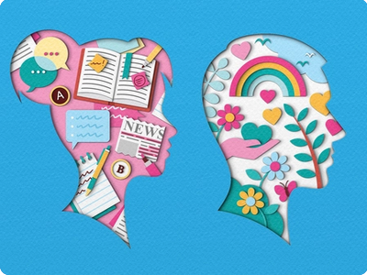
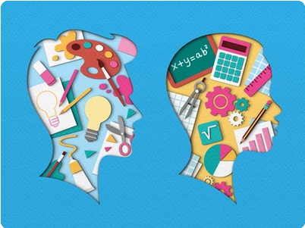
Definition
Measurable, biological differences in the
way the brain is wired to process
Social interactions
Intellectual understanding
Emotions and behaviors
A social model of disability
Credits: https://dribbble.com/zaraillustrates

Slide 3
Agenda
Abundance and not redundance
Kinder and Forgiving products
Gaming and Neurodiversity

Slide 4

Introduction
Neurodiversity is about embracing differences in the way people think and learn. By creating inclusive games, we can harness the strengths of all individuals and create a better gaming experience for everyone.

Slide 5
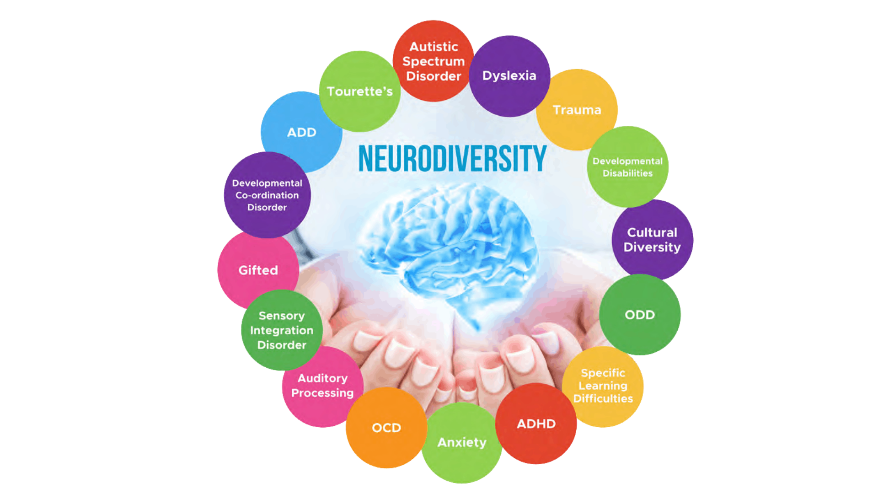
Neurodiversity is about embracing differences in the way people think and learn. By creating inclusive games, we can harness the strengths of all individuals and create a better gaming experience for everyone.

Slide 6
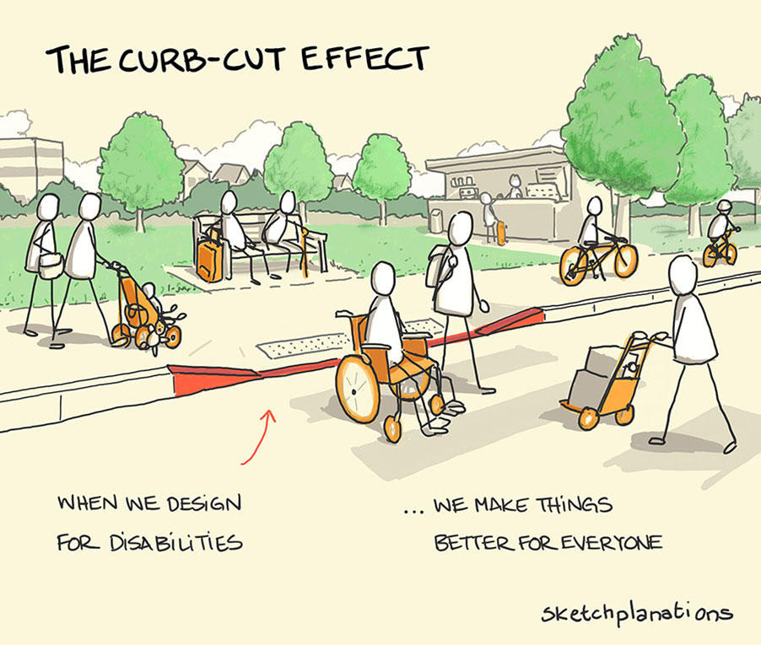
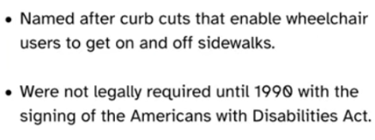
Neurodiversity is about embracing differences in the way people think and learn. By creating inclusive games, we can harness the strengths of all individuals and create a better gaming experience for everyone.

Slide 7
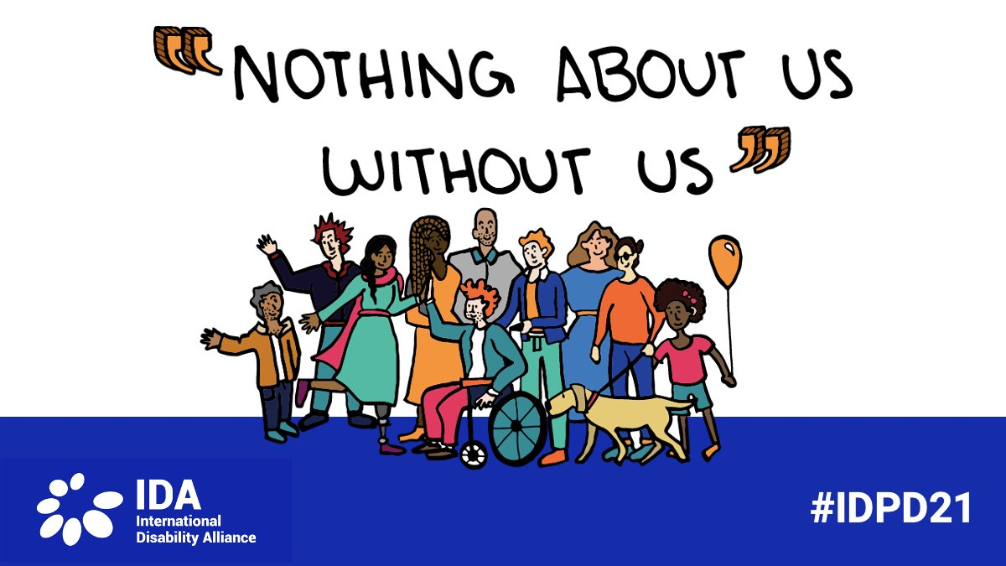

Slide 8
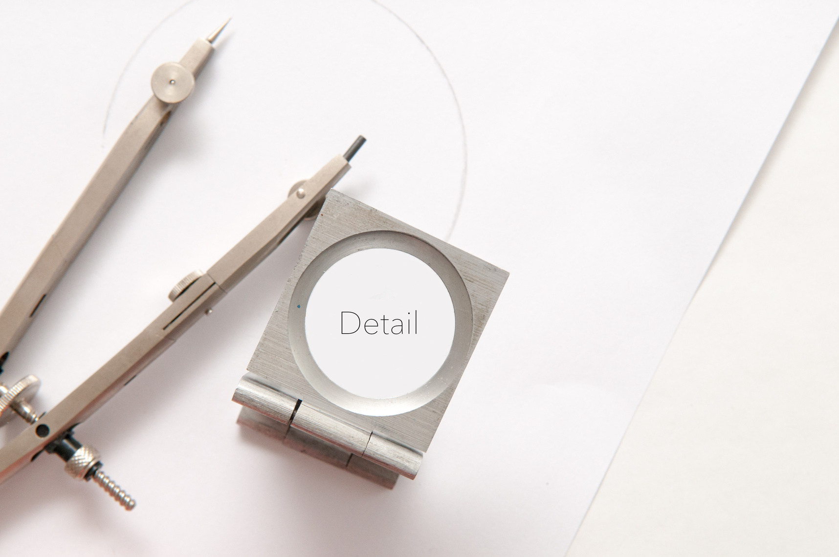

Neurodivergent traits that benefit game development
Hyperfocus on details can lead to more polished game mechanics.
Creativity and thinking outside the box can lead to unique game designs.
Pattern recognition skills can be beneficial in level design.

Slide 9
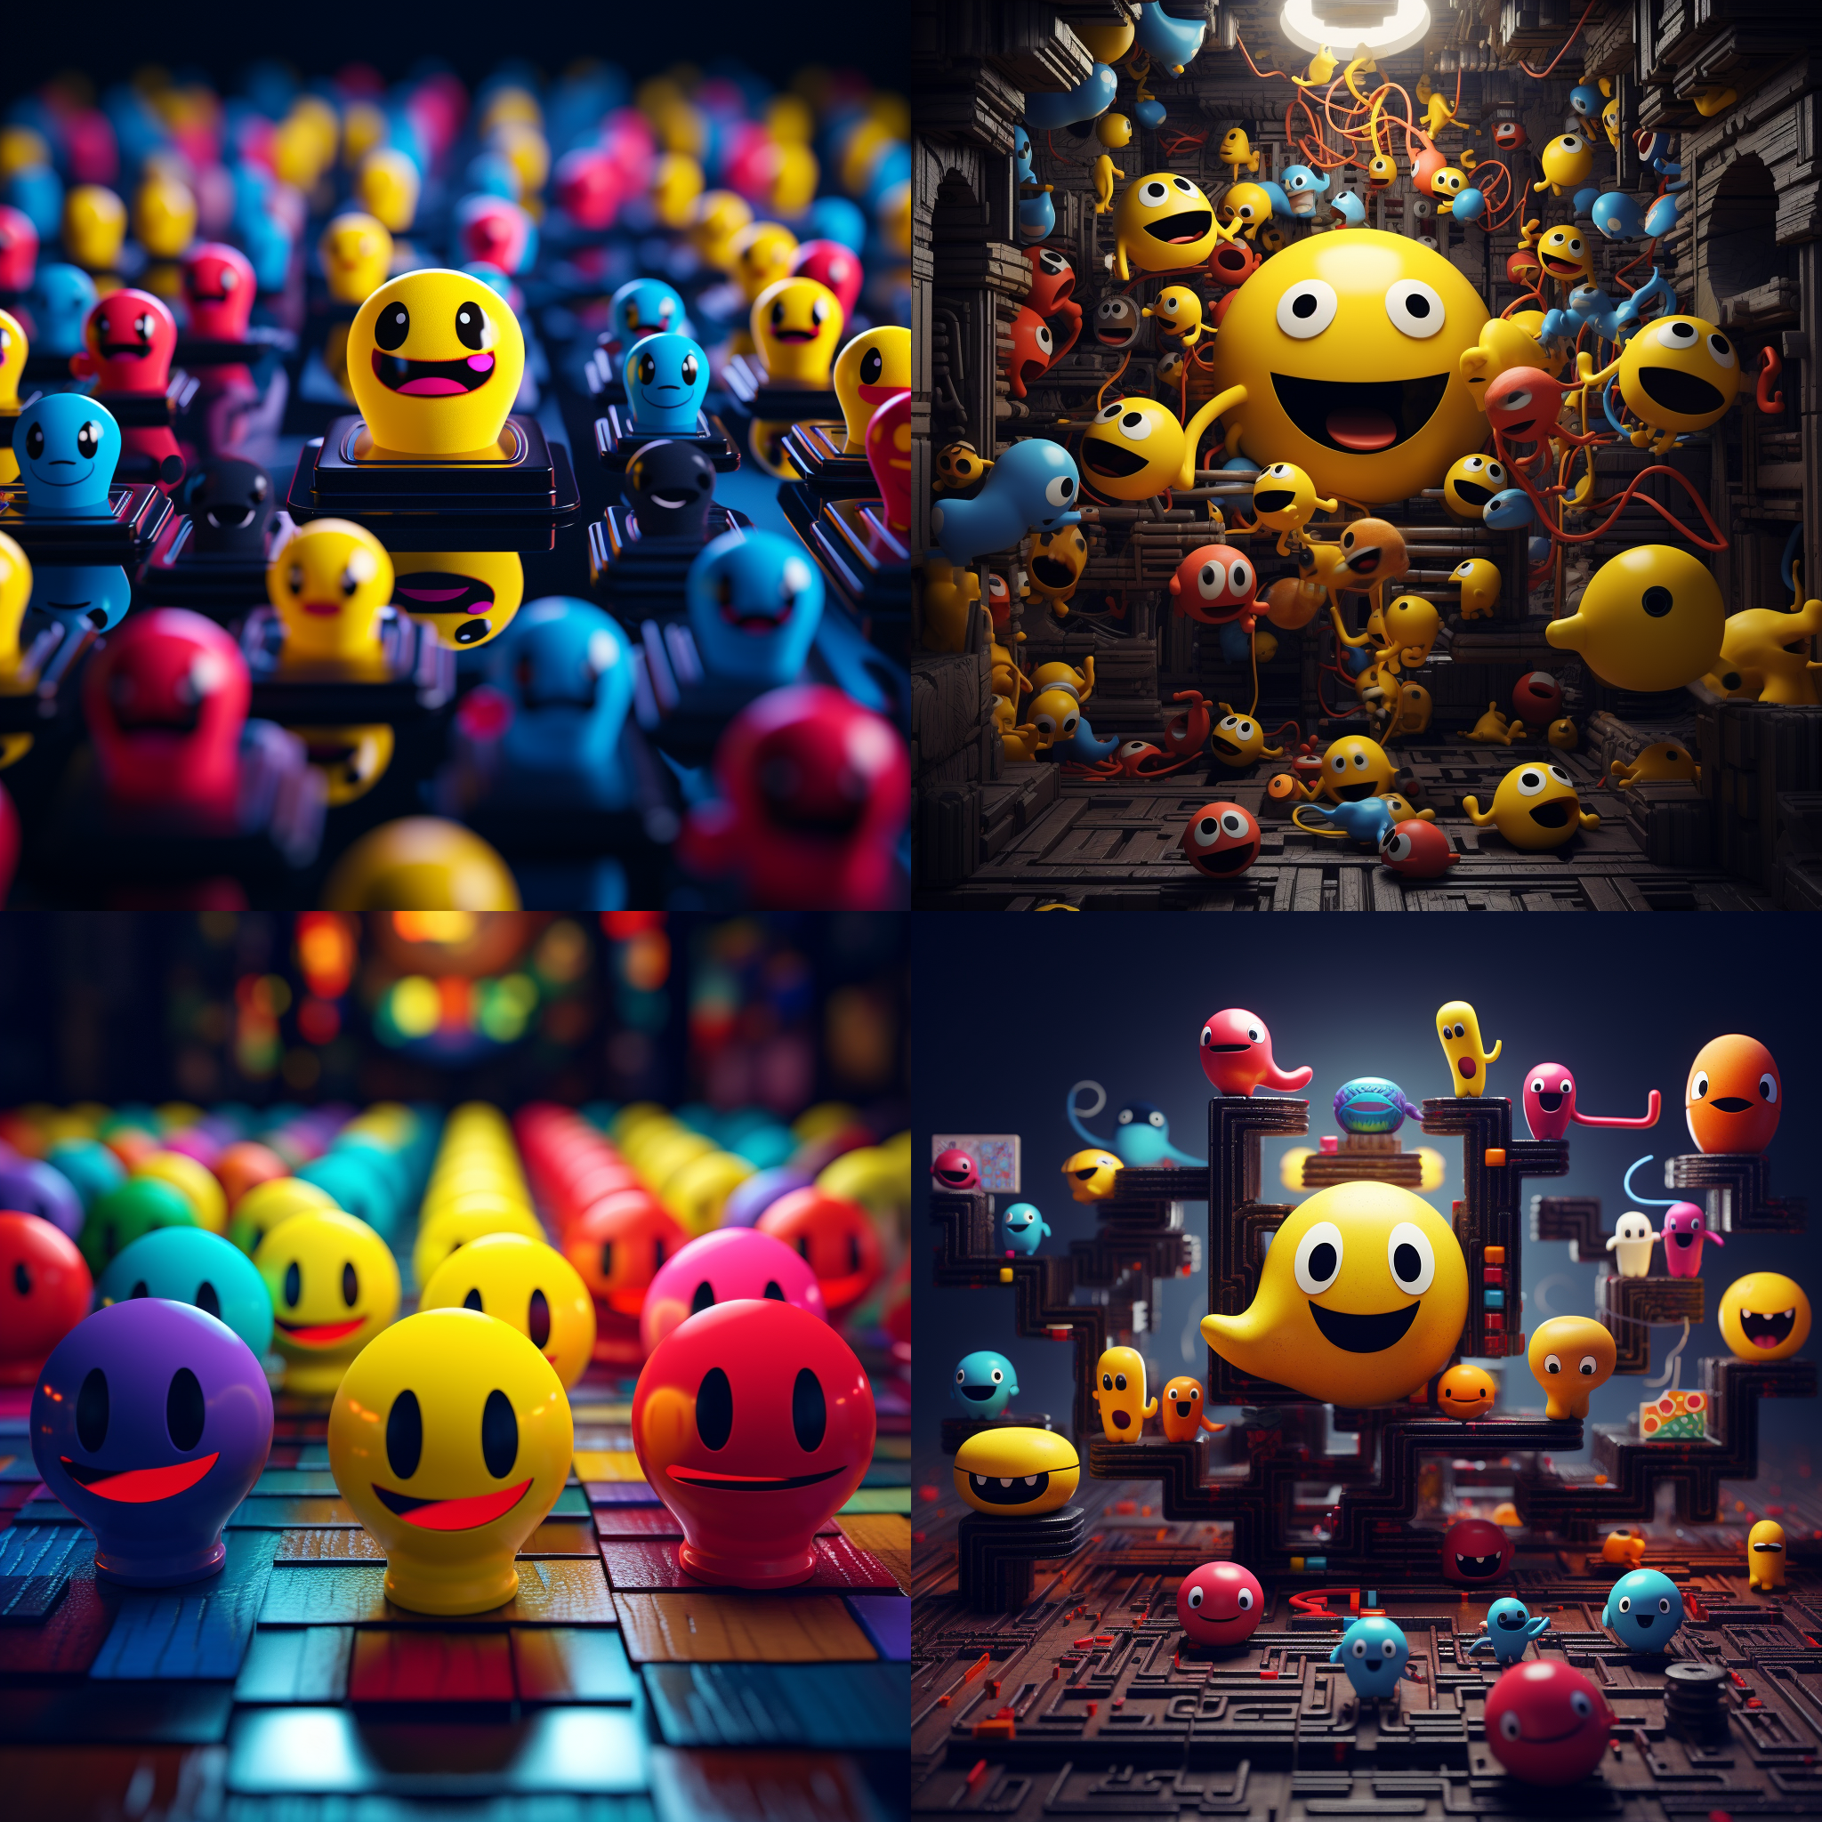

Slide 10
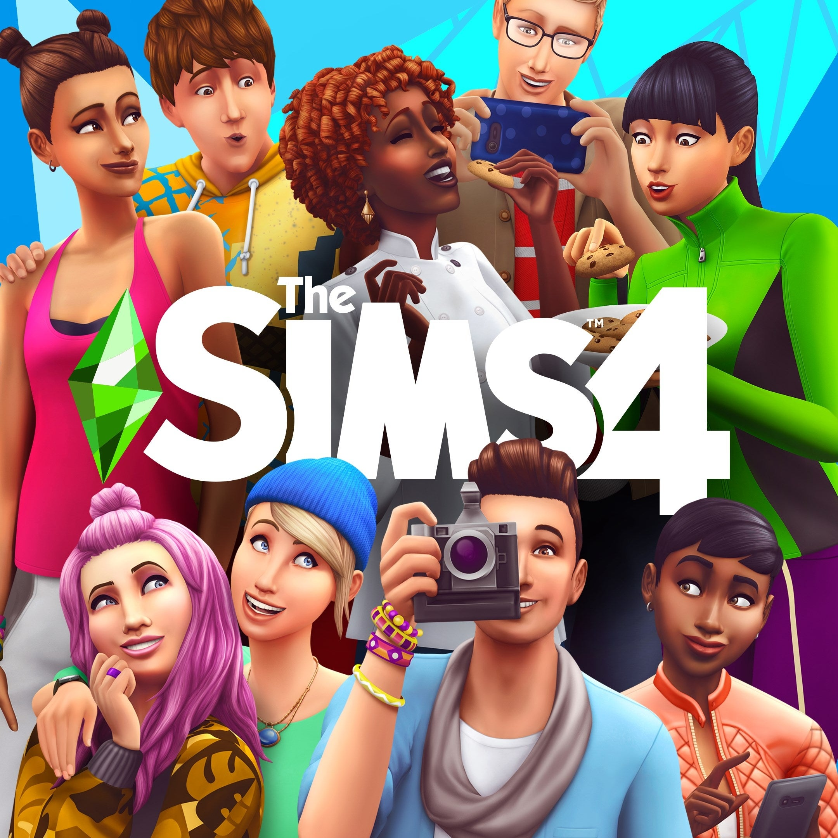
The Sims is a game of comfort for so many neurodiverse people
Neurodiversity is about embracing differences in the way people think and learn. By creating inclusive games, we can harness the strengths of all individuals and create a better gaming experience for everyone.
Notes:
Not punishing
structured social interactions and the ability to create different situations act almost like a laboratory for real life

Slide 11
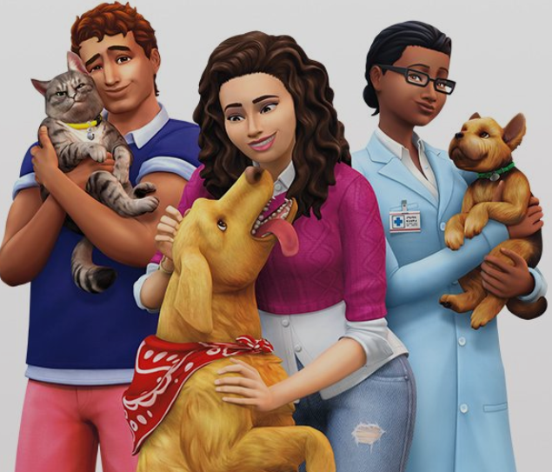
Play in different ways depending on my mood. allows to build and create
Play out different situations in a safe environment.
Explore relationship dynamics that don't come naturally to us
“A new trait – now a Sim could be an ‘overachiever.’ When applied, he would get bored and restless when his life became dormant. When he took on challenging tasks, he was so happy and fulfilled.

Slide 12
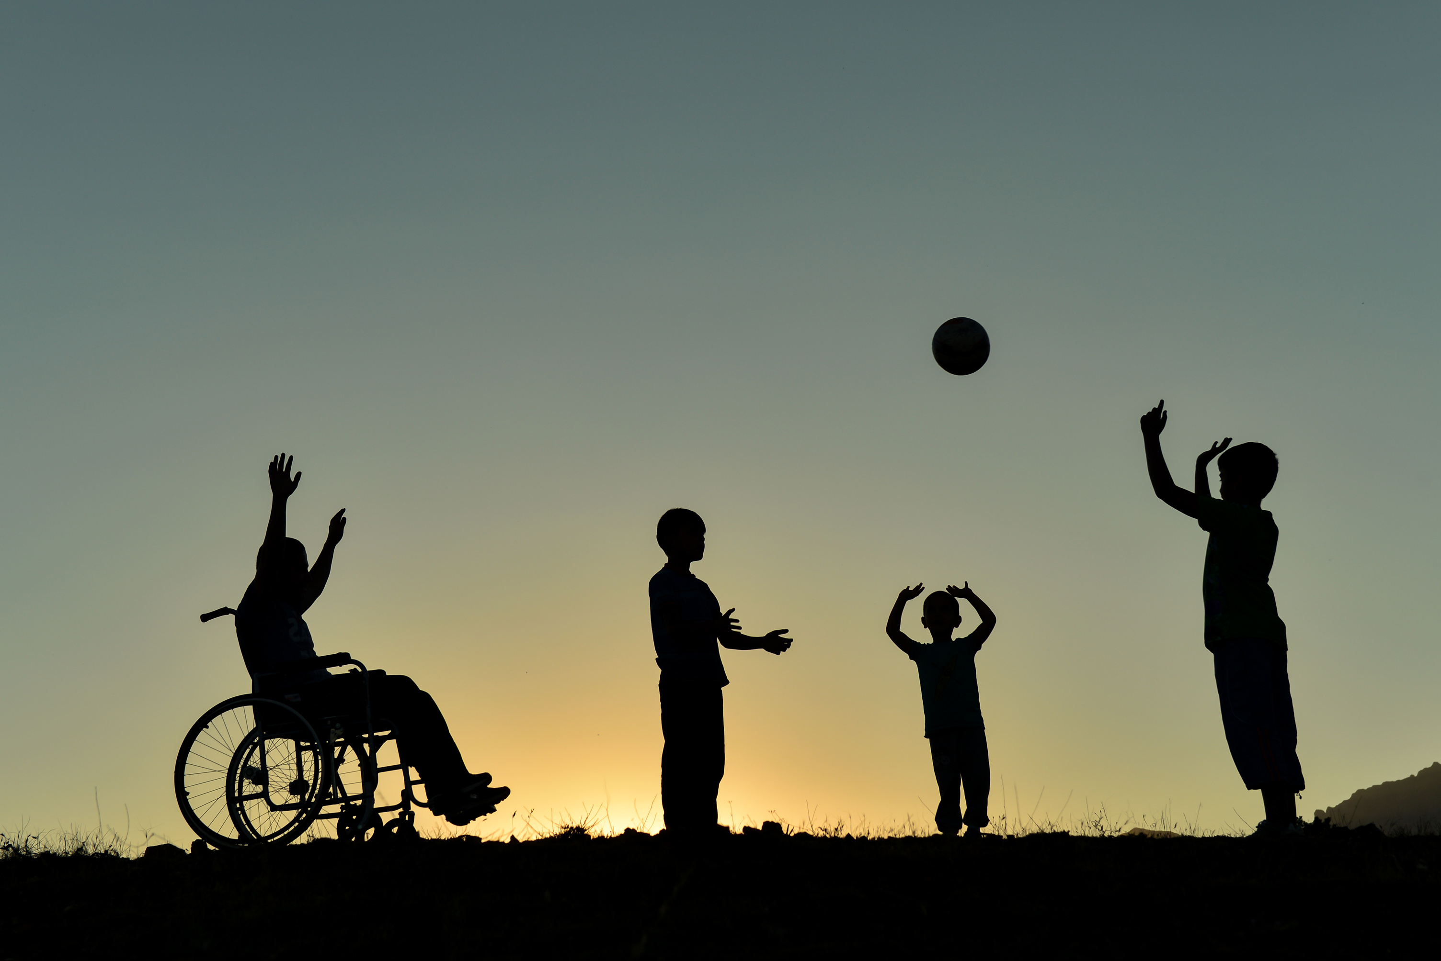
Case Study - Mario Kart
INCLUSIVITY IS KEY TO SUCCESSFUL GAME DESIGN.
EMBRACING NEURODIVERSITY IN GAME DEVELOPMENT
CAN LEAD TO GREATER CREATIVITY AND INNOVATION.

Slide 13
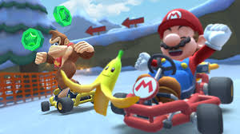
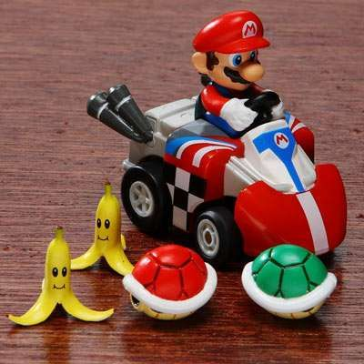
Banana a slippery slope or a booster?

Slide 14
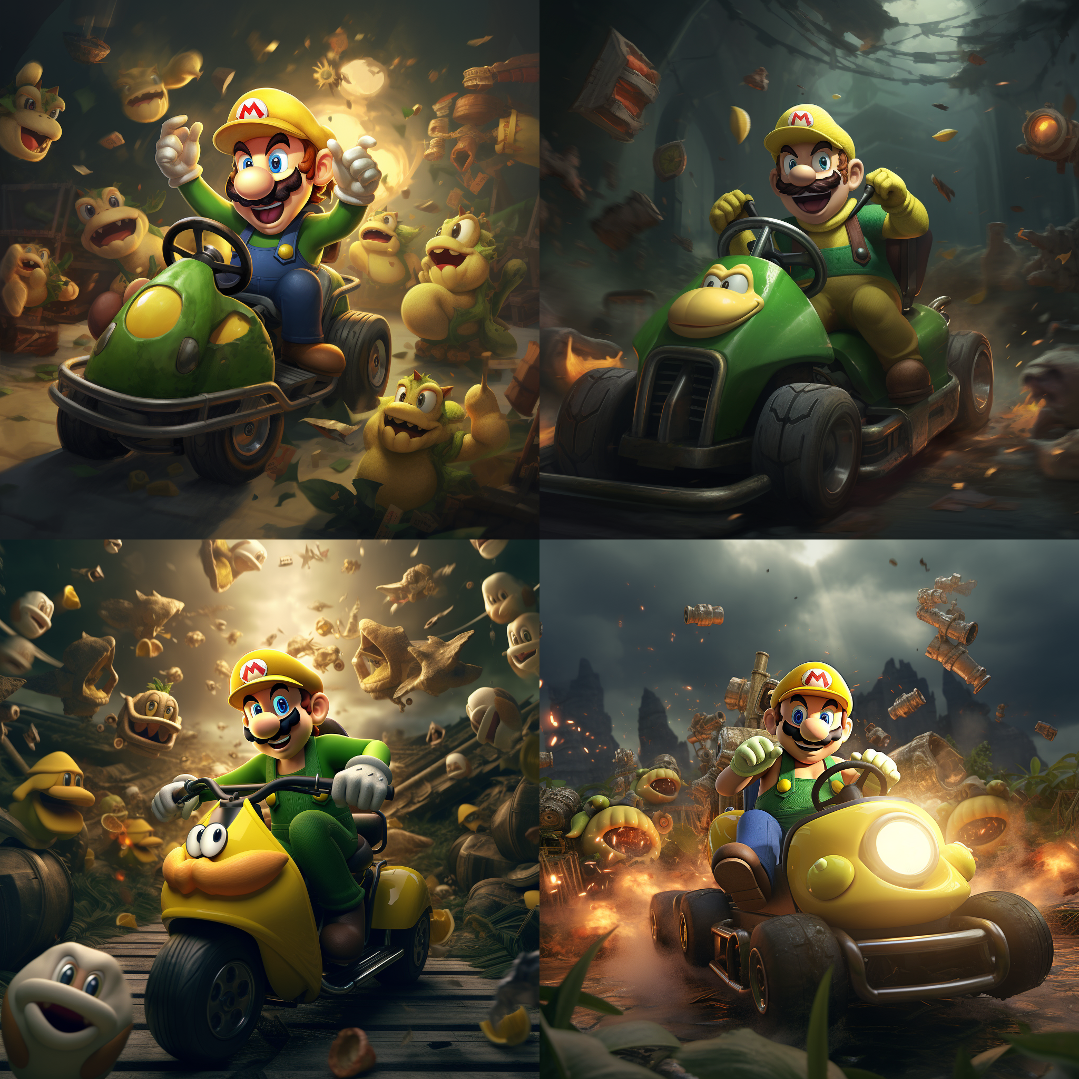

Slide 15
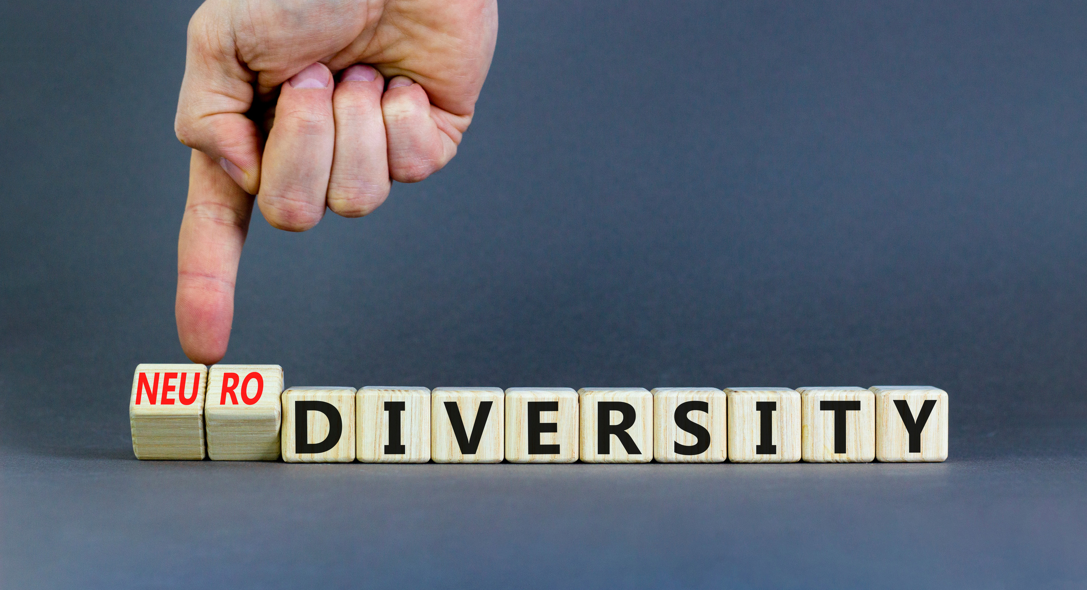
Pac-Man
When designing games, embrace neurodiversity. Consider how players on the autism spectrum or with ADHD experience your game.

Slide 16
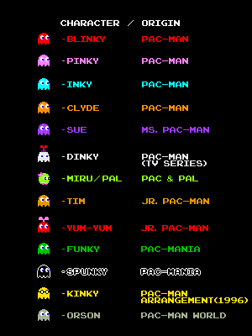
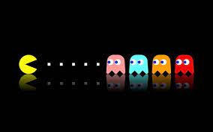
CasWhen Great Minds Don’t Think Alike!

Slide 17

Case Study - Tetris
Tetris' simple yet addictive gameplay was designed to appeal to players with a range of abilities. Its success shows the value of neurodiversity in game development.

Slide 18
Design affecting our five senses
Keeping light, acoustics,
Colour, sequencing,
Compartmentalization,
Transition,
Sensory,
Escape, and
Restoration in mind

Slide 19

Best practices for harnessing neurodiversity in game development
Use meaningful visual cues to help players navigate the game.
Incorporate different difficulty levels to cater for neurodiverse players.
Implement clear and concise instructions to avoid confusion.

Slide 20
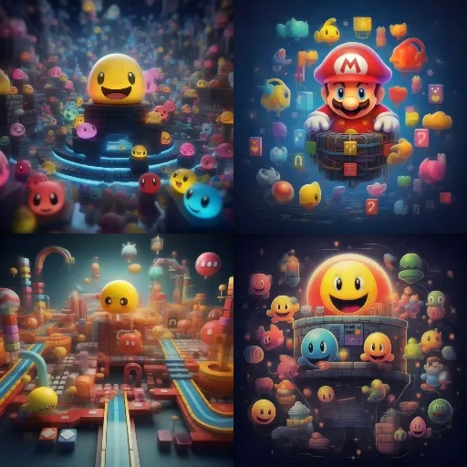

Slide 21
Great Minds Think Unalike And Learn Differently Representation Matters!

Slide 22
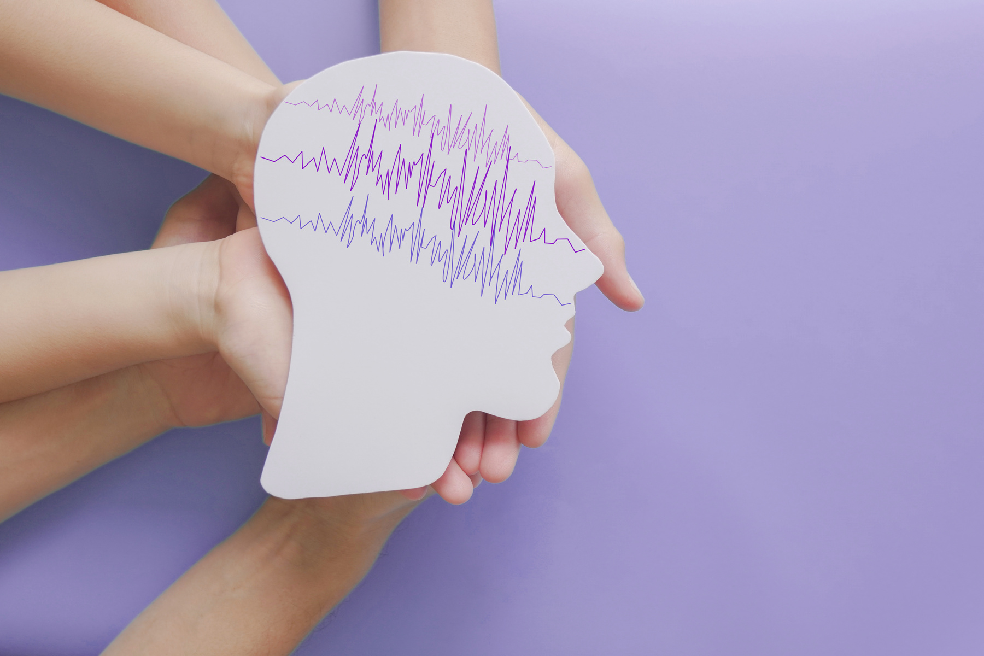
Conclusion and Call to Action
Incorporating neurodiversity into game development leads to more creativity, innovation, and inclusivity. Let's embrace and celebrate differences!

